Slide 1
Welcome to Year 1 and Year 2

Slide 2
Year 1 Monday – Wednesday: Mrs Sapoff Thursday – Friday: Mrs Campbell TA support from Mrs Tokar and Mrs Robinson.

Slide 3
Year 2 Miss Walker TAs- Mrs Adams and Mrs Cardwell Matt and Vicky will also work with Year 2 for PE.

Slide 4
Futura Learning Partnership values
The trust’s core values were chosen with the help of staff, pupils and governors:
Children benefit from being part of the Futura Learning Partnership family of schools (currently 27), where teachers and leaders work together across schools to provide the best possible education and enrichment
Children can enjoy access to the Trust’s fantastic facilities at its other schools and teachers will organise these.
Respect | Opportunity | Collaboration | Aspiration
Behaving with integrity and worthy of trust; respecting yourself, others and the environment | Providing experiences for growth and development, opening doors for future success | Working together, towards shared goals and success; being strong together | Encourage ambition; providing the inspiration, challenge and support to achieve success in all its forms

Slide 5
School Vision and values
At The Meadows Primary School, children are at the heart of all we do.
We welcome all children and their families to join our nurturing and inclusive school community. The Meadows offers fun and positive experiences that create lasting memories. Children experience a rich, creative and challenging curriculum that leads to lifelong curiosity and big dreams!
We provide a safe environment that develops resilience and encourages children to take risks, whilst learning from their mistakes. We see every child as an individual and support them on their journey to achieve success.
At The Meadows children will spread their wings and fly, with the belief that anything is possible.
Focus, Flourish and Fly.
Our school values
Honesty | Kindness | Respect | Self-belief

Slide 6
Uniform
Our school uniform consists of:
Boys: Grey trousers or shorts, royal blue jumper and a white shirt/white or royal blue polo shirt. Black school shoes.
Girls: Grey skirt/shorts/skorts or pinafore, royal blue jumper/cardigan, white blouse/white or royal blue polo shirt, and grey tailored trousers for winter wear. In the summer, a blue gingham dress can be worn.
Black school shoes/trainers – if trainers, they need to be all black.
Mobile phones – Children can ONLY bring these in if they are walking home alone and they should be handed to the class teacher – Year 5 & 6 only.
Hair - Long hair will need to be tied back as a preventative measure against the spread of headlice.
Any hair colours not considered by the school to be a natural colour, are not permitted. Make up and nail varnish is not permitted.
Jewellery – Only small, round studs may be worn and these must be removed for PE and outdoor exercise.

Slide 7
PE Kit
Please ensure that your child brings in their PE kit in a named bag on their PE days.
For term 1, this is a Tuesday and a Friday in Year 1 and Monday and Wednesday in Year 2.
If these days change, you will be notified with plenty of notice.
A full kit in KS1 consists of:
Black shorts/skorts
white plain t-shirt (No logos or football shirts)
Daps or trainers and socks.
A plain, dark hoodie/sweater and jogging bottoms can be worn during colder weather.
Please encourage your child to dress independently at home.

Slide 8
School day
Teachers will be on the playground at 8:50am
We encourage children to walk or scoot to school. We have our scooter pods for those who choose to do so. If you do need to travel by car, please be considerate of our neighbours when parking at drop off and pick up times.
Whistle will be blown at 8:55am
Children who arrive late must report to reception to sign in.
School day finishes at 3:30pm
Please let the office know if a different family member is collecting your child on a day, even if it is just once. This is for safeguarding purposes.
You will be required to give a password.

Slide 9
Resources
Children will be supplied with all of the stationery and equipment that they need.
We may ask for donations of resources for learning in lessons. Teachers will ask for these ahead of time.

Slide 10
Inhalers
All children will have taken their inhalers home at the end of the last academic year.
Children requiring inhalers – these must be brought into school (named) and a inhaler permission form will need to be filled out.
This can be done via the office when you bring the inhaler into school – it must be completed by their parent/guardian.

Slide 11
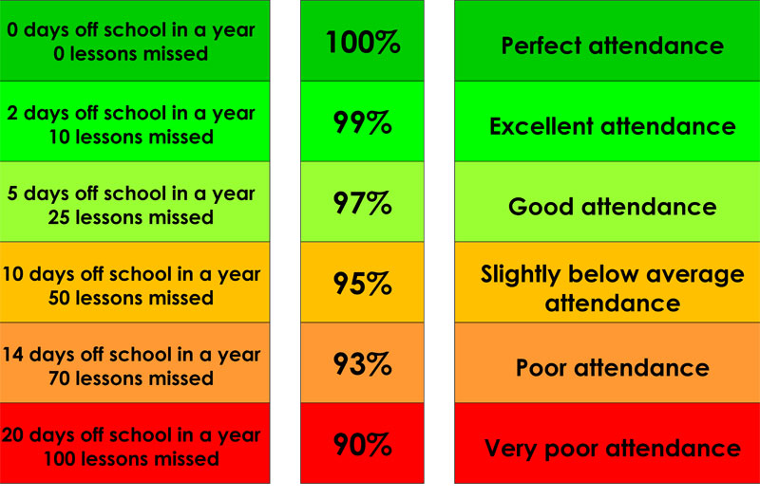
Attendance
At 9:10am, children will be classed as late
After 9.20am, it is marked as an unauthorised absence for the morning session.
Term Dates
Dates for academic terms are published on the school website before the start of each academic year.
Illness
If your child is too ill to attend school, you MUST contact the school on the first and each subsequent day of absence on the school absence line before 8.45am. If you child is suffering with diarrhoea and/or vomiting, please allow 48 hours after this has ceased.
If you’re unsure whether or not your children should attend, we suggest speaking with the school office.

Slide 12
School dinners
Our school meals are provided by Zest Catering, Futura Learning Partnership’s in-house catering service. The management team at Zest prides itself on a "fresh, healthy and tasty" ethos. They are happy to support children with food allergies or intolerances.
Current price: £2.62 per dinner. School meals are free for all pupils in Reception, Year 1 and Year 2 in state schools in England. These are known as 'universal free school meals’.
School menu web link
Please chat with your child about the menu and encourage them to try the food rather than just opting for a packed lunch.

Slide 13
Could you be eligible for Pupil Premium funding?
If so, as well as getting a free school lunch, your child will get access to free breakfast club and toast at playtime as well as the school receiving funding to support your child in a range of different ways.
We are also offering a free school jumper, if a successful application is made this term.
Please see the letter that has been emailed out to all parents.
If you need any support with this, please contact Mrs Holmes, who is our Pupil Premium lead.

Slide 14
Behaviour
The Meadows Primary School is committed to creating an environment where exemplary behaviour is at the heart of productive learning. Everyone is expected to maintain the highest standards of personal conduct, to accept responsibility for their behaviour and encourage others to do the same. As members of our community, we adhere to the values of being: ‘Honest, Kind and Respectful.’ These values are how we expect children to behave.
We promote positive learning :
- house points.
- Praise pads/postcard home
- Wow certificates
- Celebration certificates (weekly)
- Above and beyond afternoon tea

Slide 15
Raindrops – only 3 displayed in class
Level 1 – children will have a warning and a verbal agreement of understanding between adult and child will be made. Staff may need to speak to parents at the end of the day to inform them of behaviours they are noticing
Level 2 – Child will have reflection time in a partner class – a restorative conversation will be held. Staff may need to speak to parents at the end of the day to inform them of behaviours they are noticing
Level 3 – Child will have reflection time with a member of SLT during a breaktime/or immediately. Strategies will be planned to be successful moving forwards. Teacher will telephone/speak with parents at the end of the day. If behaviour is persistent, SLT monitor patterns and write to parents to arrange a meeting.
Level 4 and Level 5 are in place – see the policy for further information on these

Slide 16
Anti-Bullying
The repetitive, intentional hurting of one person by another.
(STOP: Several times on purpose)
Bullying can be carried out physically, verbally emotionally or online.
Bullying of any kind is unacceptable at our school
Everyone has the right to feel welcome, safe and happy
We should treat everyone with respect
If bullying happens it will be dealt with quickly and effectively
Please click on the link to see our Anti-Bullying policy for further detail.
Policies

Slide 17
 | The Meadows Primary School – KS1 – Year 1
 | Monday | Tuesday | Wednesday | Thursday | Friday
8.55 – 9.00 | Register | Register | Register | Register | Register
9.05 – 9.45 | RWInc Phonics/WCR | RWInc Phonics/WCR | RWInc Phonics/WCR | RWInc Phonics/WCR | RWInc Phonics/WCR
9.45 -10.45 | English including 5 mins novel time | English including 5 mins novel time | English including 5 mins novel time | English including 5 mins novel time | English including 5 mins novel time
10.45 – 11.00 | Break
11.00 – 11.10 | Outdoor- Maths Meeting | Maths Meeting | Maths Meeting | Maths Meeting | Maths Meeting
11.10- 12.00 | Maths | Maths | Maths | Maths | Maths
12.00 – 1.00 | Lunch break
1.00-1.15 | Register Reading | Register Reading | Register Reading | Register Reading | Register Reading
1.15­ – 2.15 | Outdoor | PE | DT | Science / Geography | PE
2.15- 3.00 | Science / Geography | Computing | Explore and Learn | Explore and Learn | Celebration assembly
3.00-3.20 | Assembly | Music | PSHE | Assembly | Free time Friday
3.20 – 3.30 | Class tidy and ready for home | Class tidy and ready for home | Class tidy and ready for home | Class tidy and ready for home | Class tidy and ready for home

Slide 18
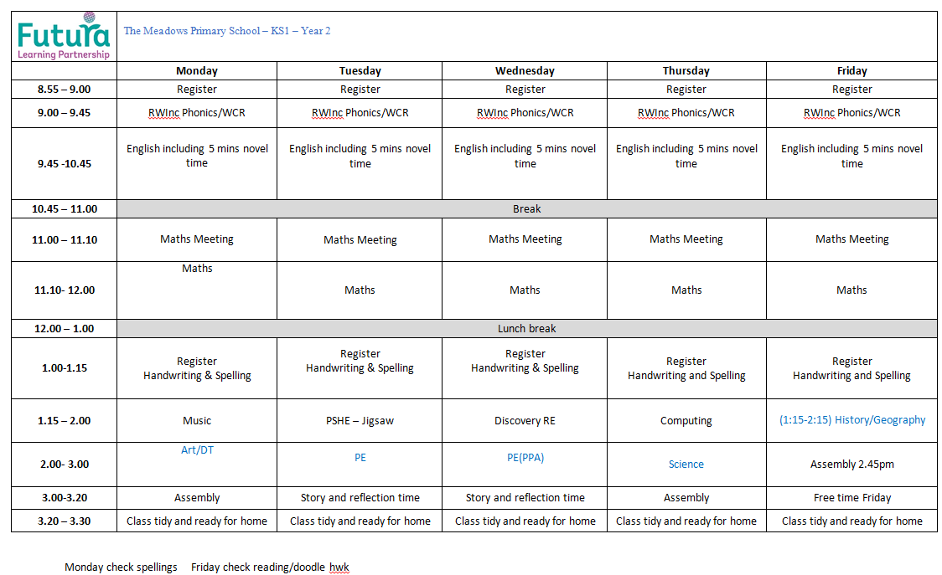

Slide 19
Homework
Maths Homework – Checked on Fridays
Children will be using DoodleMaths and are expected to complete their weekly target of stars. They are tracked over 7 days and this resets again each week. If children fail to complete their target, this will be discussed with the child and they will be asked to complete it during ‘free time Friday’. If children consistently fail to reach their target, this will be discussed with parents and carers. This will be checked on Fridays.
English homework
In KS1 children will have 5-8 spellings. Please ensure children practice these at home as well as learning words from the statutory spelling list. (Checked on Mondays)
We expect to see these practised more than once.
Please also read with your child 4 times per week – asking questions to further their understanding of the text. (Checked on Mondays)

Slide 20
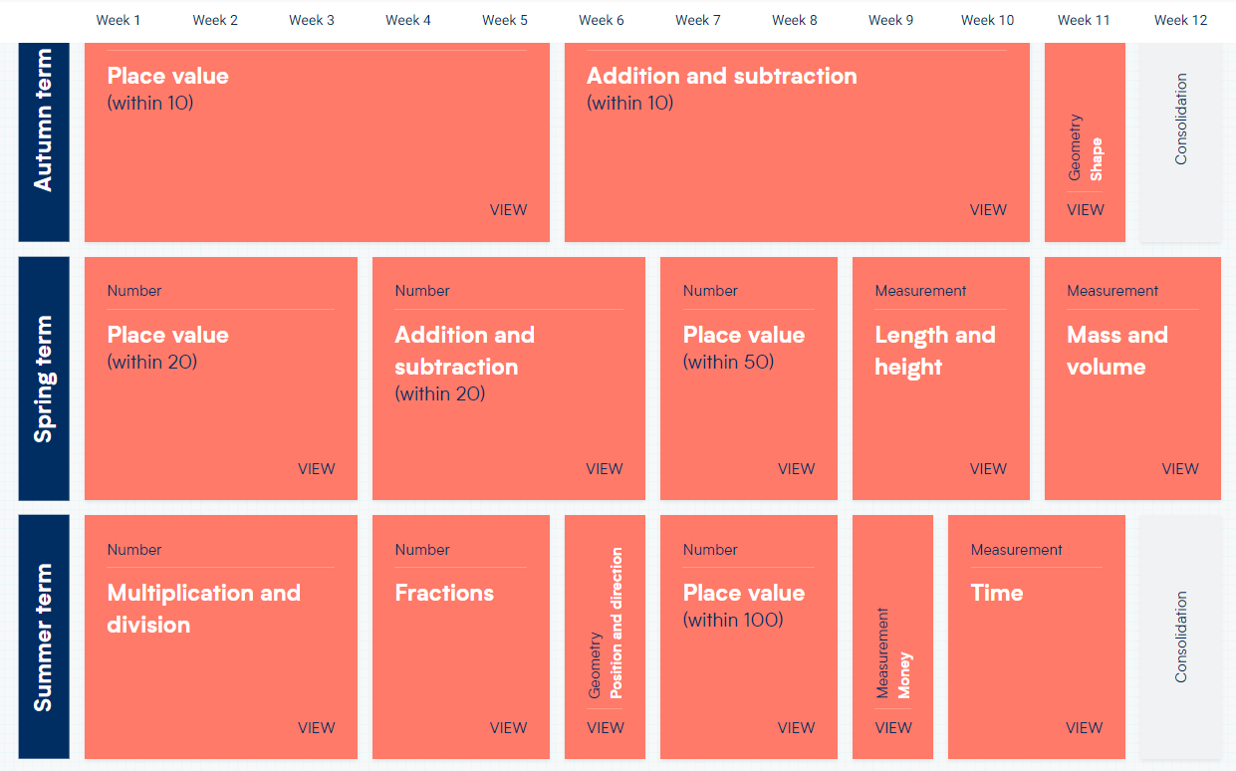
Maths
We follow White Rose Maths scheme of learning – This is Y1’s mapped for the year

Slide 21
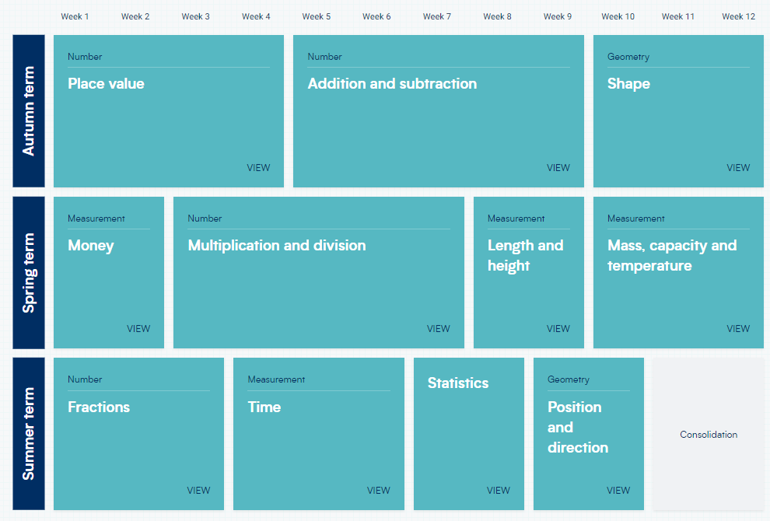
Maths
We follow White Rose Maths scheme of learning – This is Y2’s mapped for the year

Slide 22
English
WRITING
We plan our English around a text for each term and all writing is based around this high quality text.
Children will be taught a skill and they will practise this, followed by a short writing piece where they apply this school.
Each writing unit will have long writing outcomes as well.
Children will learn their grammar curriculum within their English lessons
READING
Most children will take part in phonics sessions. We work in small groups and children are re-assessed every 6 weeks. We change books every 3 days so please make sure they are always in school.
Whole class reading lessons usually start in Y2 from January and we follow VIPERS.
VIPERS focuses on all the different reading skills and children spend time reading texts as well as building their comprehension skills.

Slide 23
PE
Term 1 | Term 2 | Term 3 | Term 4 | Term 5 | Term 6
Locomotion (Running) Gymnastics | Ball Skills (Hands) Dance | Rackets, Bats and Balls Gymnastics | Ball Skills (Feet) Dance | Locomotion (Jumping) Team Building | Games for Understanding Ball Skills (Hands 2)

Slide 24
Geography / History
Term 1 | Term 2 | Term 3 | Term 4 | Term 5 | Term 6
Geography Compare and contrast our locality to Australia (seaside) | History Great Fire of London— Samuel Pepys Guy Fawkes | Geography Weather (hot and cold) Continents and Oceans | History George Cadbury Local History of Keynsham Castles | Geography The UK Study of our school locality | History Transport— Brunel

Slide 25
Science
Term 1 | Term 2 | Term 3 | Term 4 | Term 5 | Term 6
Habitats Food chains | Material | Seasonal Changes | Exercise, Food and Hygiene | Plants | Animals and life cycles

Slide 26
RE/Music/PSHE
Term 1 | Term 2 | Term 3 | Term 4 | Term 5 | Term 6
Creation Story What did Jesus teach? (Christianity) | Christmas (Christianity) | Jesus as a Friend (Christianity) Passover (Judaism) | Easter (Christianity) | Shabbat (Judaism) Community and Belonging (Islam) | Rosh Hashanah and Yom Kippur (Judaism) Hajj (Islam)
Rhythm & Pulse | Pitch | Singing Games | Instrumental | Consolidate | Singing
Being in my world | Celebrating differences | Dreams and goals | Healthy me | Relationships | Changing me

Slide 27
Trips and visitors
We like to provide our learners with lifelong memories and encourage their curiosity to learn.
Although contributions are voluntary, schools are not in financial positions to fund these enrichment experiences.
We have a very generous PTA that can sometimes subsidise many experiences but we do need parental contributions.
We realise times are difficult at the moment and it is essential that you speak to the office this term if you feel you will be unable to make payments this year, so the school can try and budget for this.
If we have not heard that you need support with trip contributions then we will expect payments to be made.
If we do not get enough support with this then trips and experiences will be unable to go ahead.

Slide 28
Y1/2 trips and visitors (paid for)
Fire of London Workshop
Visiting theatre
SS Great Britain

Slide 29
How can you support your child?
Practice your child’s maths homework and spellings with them frequently
Recap previous learning too.
Practice the methods taught in maths with your child to build fluency.
Buy your child a watch and get them to tell the time as much as possible.
Use the websites and apps, including TT Rockstars and Doodle, shared with you to support your child.
Read with your child every day to support their fluency, expression, reading comprehension and vocabulary

Slide 30
Reading at home

Slide 31
Assessment
In Year 2 assessments will be done 3 times a year. The final one being their SATs exams.
Autumn and Spring assessments will be done to give me a true picture of progress and gaps.
Y2 SATs are scheduled for May 2024. Although non-compulsory, children will be taking these.
Children’s writing will be moderated within the Futura Learning Partnership and South Gloucestershire.
We will have pupil progress meetings to identify and intervene with children that are off-track.
We will inform you if this is happening for your child.
Year 1 will sit assessments in the summer term.
Year 1 will have a phonics screening check in June 2024.

Slide 32
Contact us
Playground (Teachers are available on the playground from 8:50-8:55 for quick messages/chats.)
Email/phone school office – all messages will be forwarded onto teachers and you will get a response.
If you require an appointment for something that needs longer, this can be made via email.

Slide 33
Assemblies
Whole School Assemblies
We will deliver two assemblies per week. These will be focused on our personal development curriculum.
Celebration assembly – These are every Friday at 2:45pm.
Parents of nominated children will receive a letter inviting them to attend.
If you cannot attend, you can contact the office and we can move it to the following week.

Slide 34
Photo consent
Your photo consent preferences will be automatically carried over. Please email the office if you wish to change these at any point.

